Slide 1
CS 736: Advanced Operating Systems Andrea Arpaci-Dusseau Persistent Memory
Compare two approaches for handling Persistent Memory
Mnemosyne: 2011
Strong motivation, identifying technology trends and important issues
Implementation of complete system
LevelHash: 2018
Very focused solution for one particular data structure (hash table)
Neat techniques
Compare and contrast the two, alternating discussion of each
Use authors’ slides from their talks

Slide 2
Mnemosyne Lightweight Persistent Memory
Haris Volos
Andres Jaan Tack, Michael M. Swift
University of Wisconsin – Madison
ASPLOS 2011

Slide 3
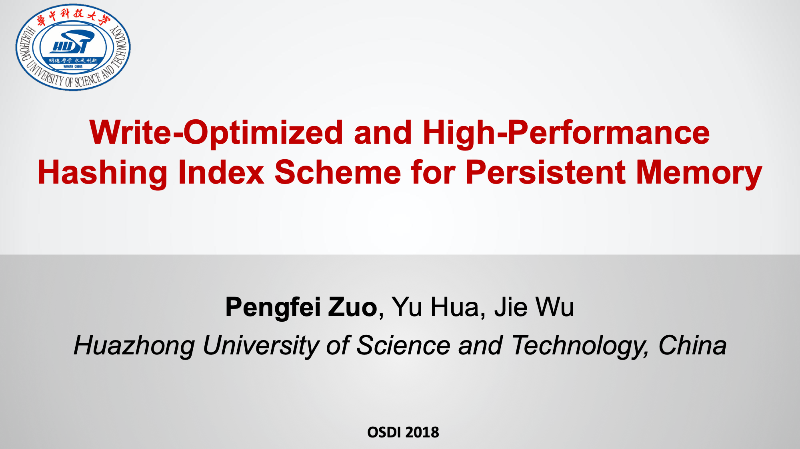

Slide 4
Motivation?

Slide 5
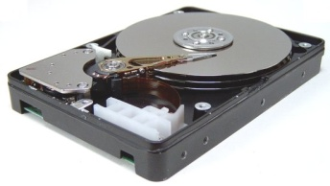
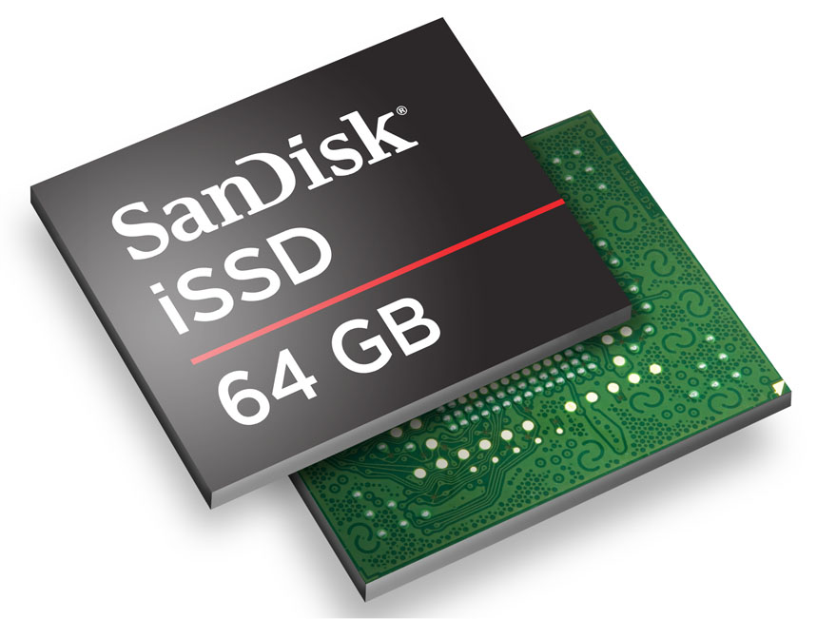
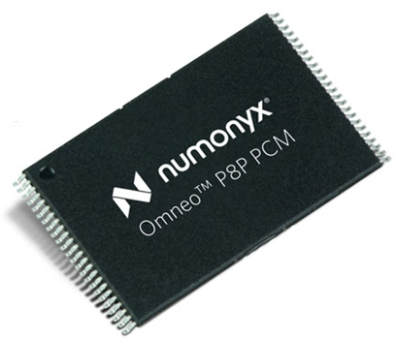
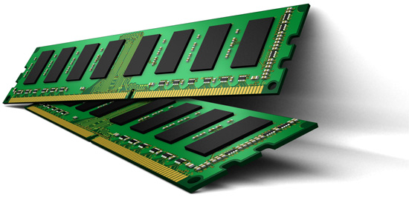
Storage: Past, Present, Future
Storage-Class
Memory
(fast, byte, persistent)
Storage
(slow, block, persistent)
Memory
(fast, byte, volatile)

Slide 6
Storage-Class Memory (SCM)
Features
Persistent
Memory-like interface (load/store)
Short access time
ns
μs
ms
Latency

Slide 7
Existing system interface mismatches SCM
Memory: load/store/mmap()
Storage: read()/write()/fsync()
Requirements
Performance
Persistent Naming
Crash Consistency
Protected Sharing
Memory | Storage
✔
 | ✔
 | ✔
 | ✔

Slide 8
Memory lacks storage features: No persistent naming
Virtual memory treats pages as identical
Persistence requires identifying pages
Virtual Address
Memory
Today
0xC02
OxFFFF0000
Next week
0xDEADBEEF

Slide 9
Memory lacks storage features: No crash consistency
Memory discards all its contents on a crash
Persistence requires preventing partial updates
A
B
C
Missing back ptr
list_add(B,C)
{
STORE B.next = C
STORE C.prev = B
}
CRASH

Slide 10
The abstraction cost of File
Universal abstraction: Everything is a file
Has generic-overhead cost
Application
write()
Virtual File System
File System
~5μs
SCM FS

Slide 11
Goals summary
Performance
Persistent naming
Crash consistency
Protected sharing
Want flexibility
Key Mechanism
Direct access to storage from user mode

Slide 12
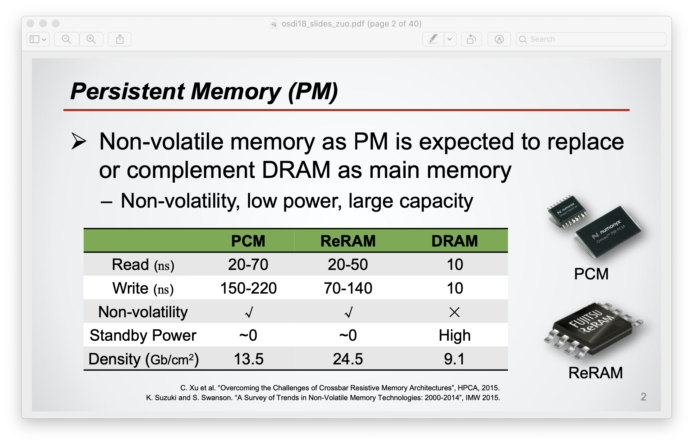

Slide 13
Goals?
Applications?
Issues?
Model?

Slide 14
Application Trends: Low-latency storage
Web applications
Amazon
Facebook
Desktop applications
Firefox (frequent fsyncs)
Other
Distributed agreement protocols
High-frequency trading
Notes:
On the other hand, while flash can provide high bandwidth storage, we see an increasing body of evidence that applications could benefit from low-latency storage, which is one of the major advantages of SCM over flash. Such applications have storage on the critical path but are not willing to trade data integrity for performance.
This is evident in web applications such as Amazon and Facebook…
In the desktop world, Firefox needs to call fsync frequently to ensure that users’ history updates are not lost as losing data always makes users sad…
Other examples include:
-Distributed agreement protocols such as Paxos that need to synchronously write to a log.
-High-frequency trading requires fast access to data to perform real-time decisions.

Slide 15
GOAL: Flexible Low-latency Storage
Idea 1: File System
Layering overheads
Idea 2: Persistent Object Stores
Single data-storage model
Our idea: Persistent Memory
+Flexible and fine-grain
+Low-latency
Notes:
The first idea is making SCM available through a file system. This approach however adds layering overheads as accessing the file system requires trapping into the operating system, accessing the virtual file system layer, which sits on top of every file system, and copying data between user and kernel. The total overhead can be up to three orders of magnitude larger than the latency to SCM, thus handicapping performance.
Another idea is to use language integrated persistent …
Persistent memory:
-Enables fine-grain access by allowing flexible byte-level manipulation of in-memory data structures
-Enables low-latency storage as there are no intermediate layers to add overhead.
Let me now give a bird’s eye view of persistent memory.

Slide 16
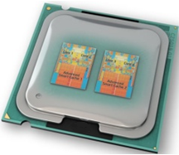


Persistent Memory
Address Space
Memory Controller
Consistent Updates
prevent inconsistent state
Inconsistent state
(missing pointer)
DRAM
SCM
Notes:
At the lowest level we assume an SCM DIMM that similarly to a DRAM DIMM is plugged on the memory bus. We also assume that the DIMM supports single-word atomic updates.
Here is the address space of an application using persistent memory…
A programmer can store stuff in persistent memory ...
In constrast to volatile regions, …
One though has to be careful when performing a multi-word update such as updating a doubly linked list. A failure midflight the update …

Slide 17

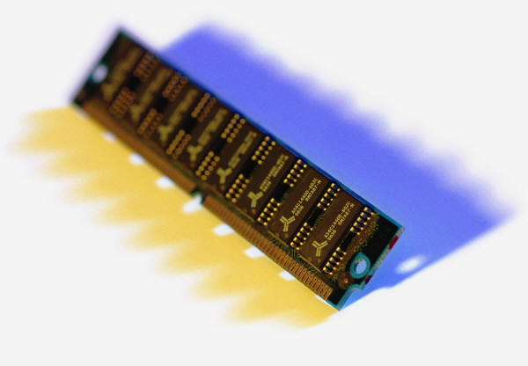
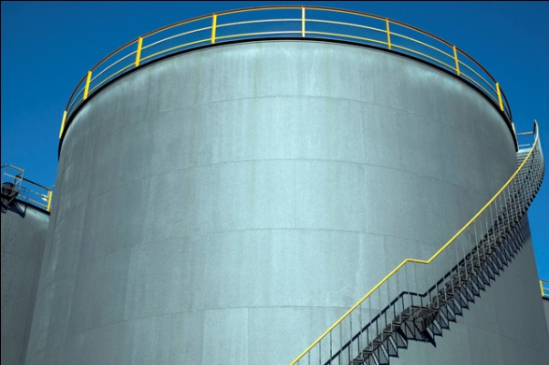
In-vivo Persistence
In-vitro vs. In-vivo persistence
Example: OpenLDAP
Logic-tier
Caching-tier
Storage-tier
In-vivo persistence
In-vitro persistence
Handle Request
In-memory Directory
Berkeley DB
Notes:
Persistent memory enables a model of what I like to call in-vivo persistence.
Consider this typical software organization when dealing with data.
-Left: Logic-tier implements applications functionality.
-Middle: Caching-tier keeps a fast in-memory data structure for frequent access.
-Right: Storage-tier keeps a durable version in a storage system such as a database.
I call this model in-vitro persistence as the storage-tier is separated from the application.
However in the case when you can fit all your data in SCM, then persistent memory enables in-vivo persistence as it integrates the storage tier into the in-memory caching-tier effectively simplifying the persistence model.
OpenLDAP:
-keeps directory in-memory for fast lookup and access, and also in a berkeley DB backend for persistence.
-with persistent memory, we can drop BDB and keep a single persistent in-memory directory which simplifies the persistence model and can also improve performance by having direct access to SCM.

Slide 18
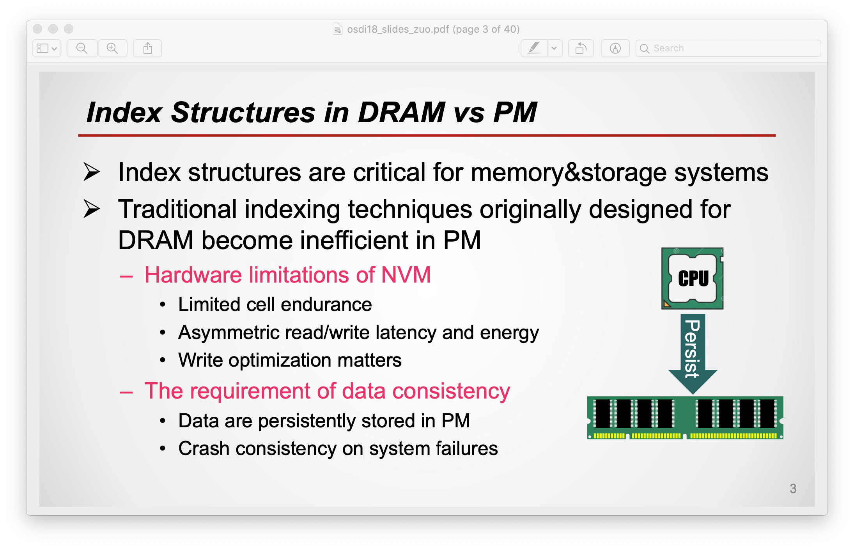

Slide 19
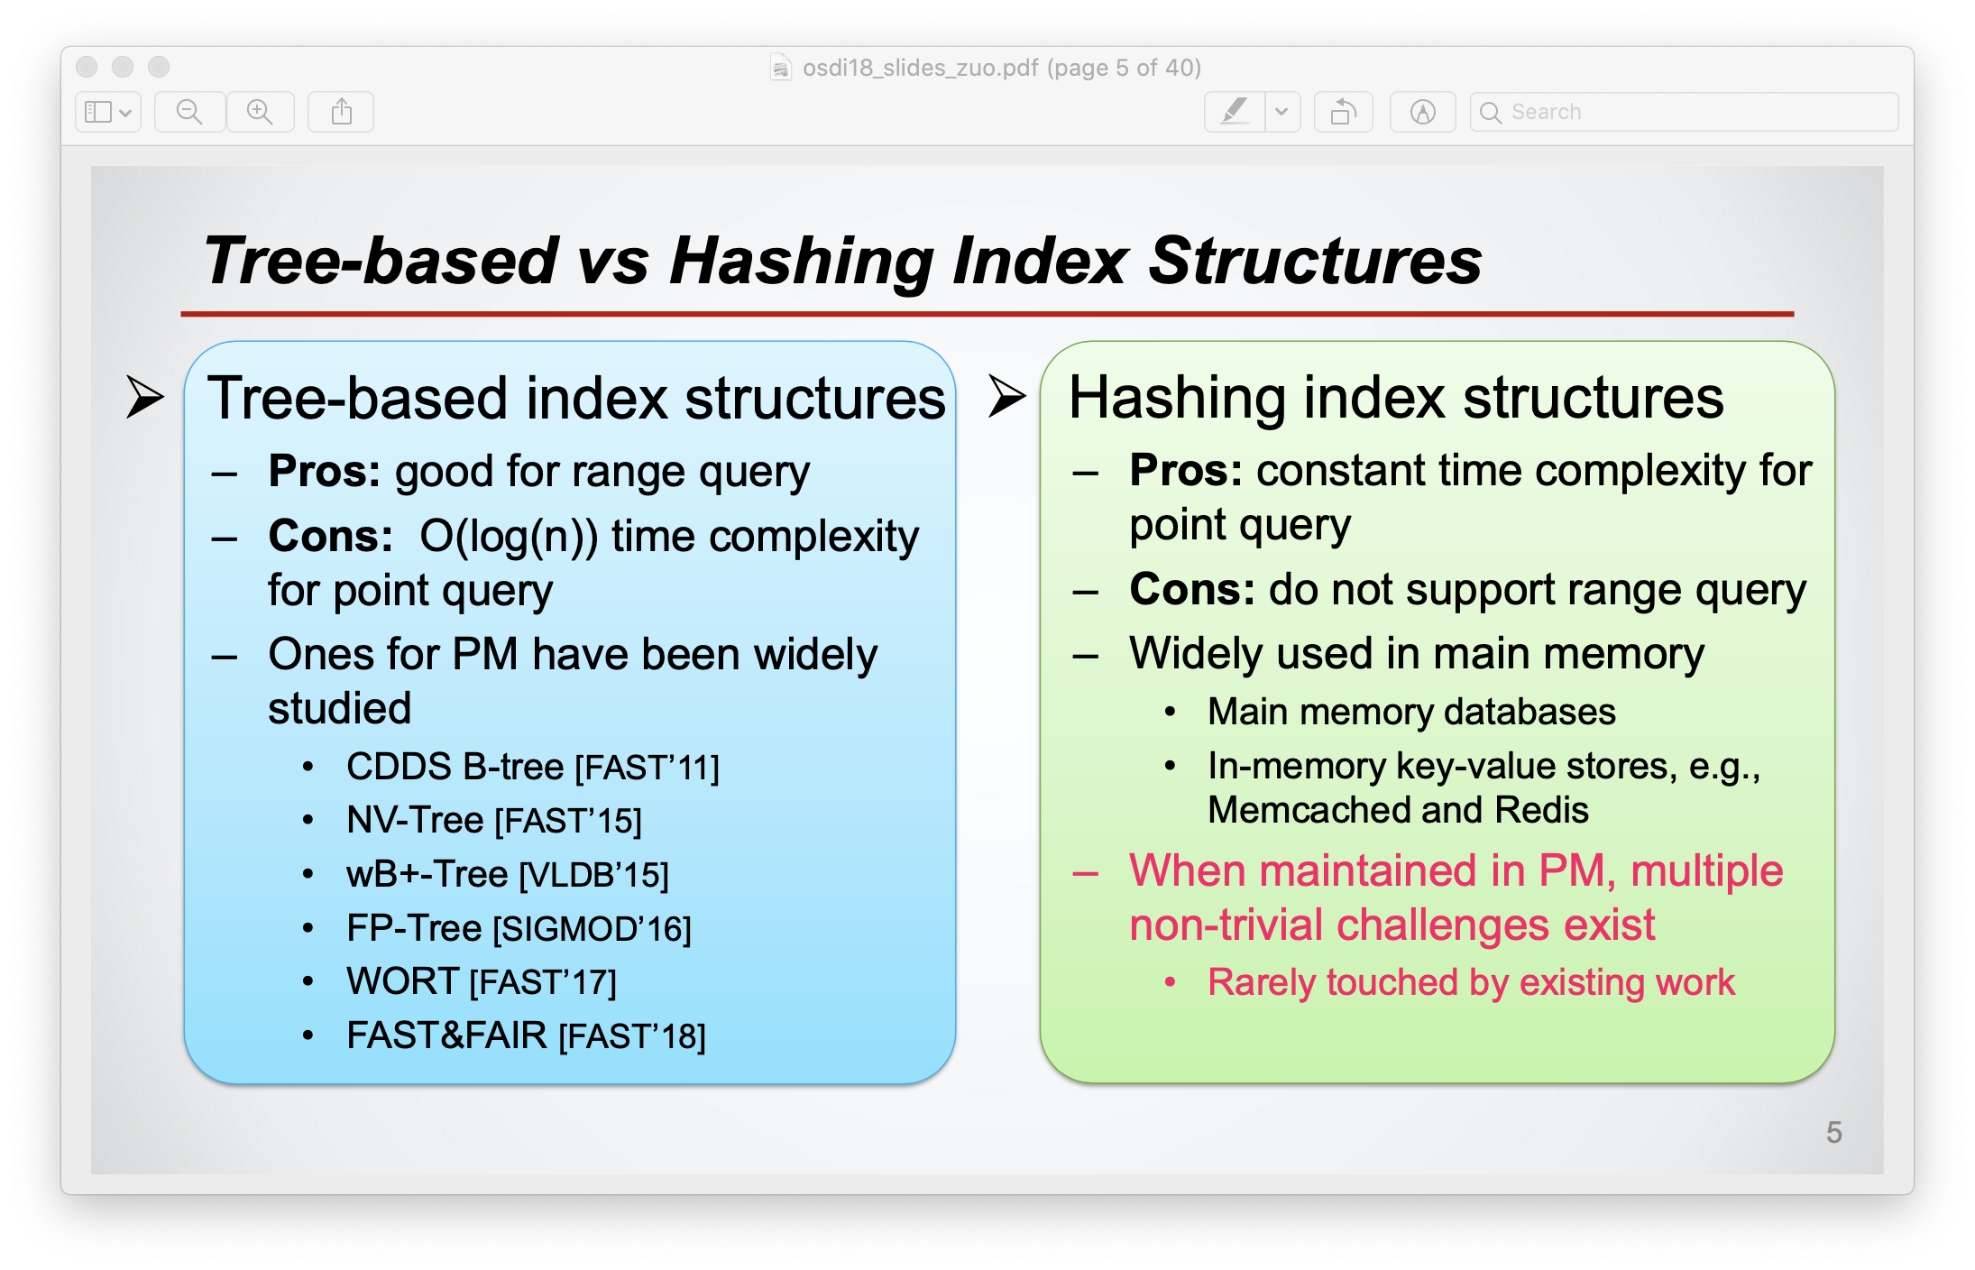

Slide 20
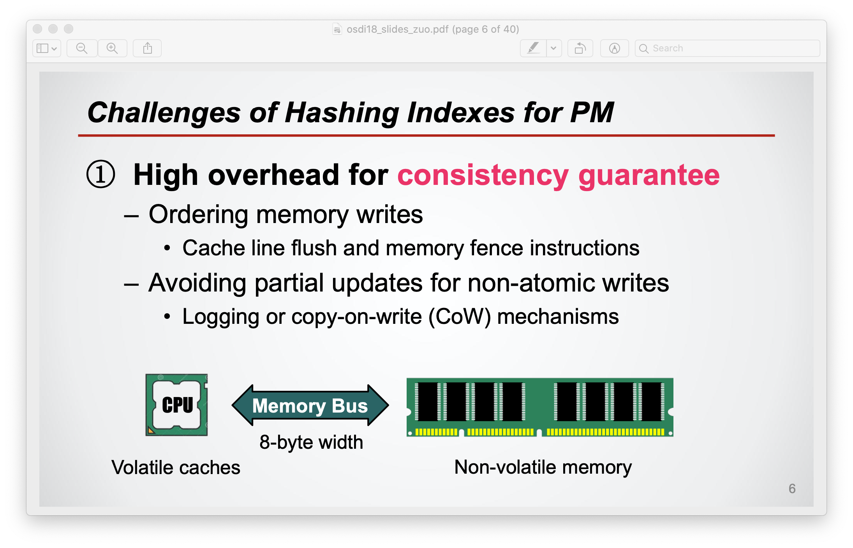

Slide 21
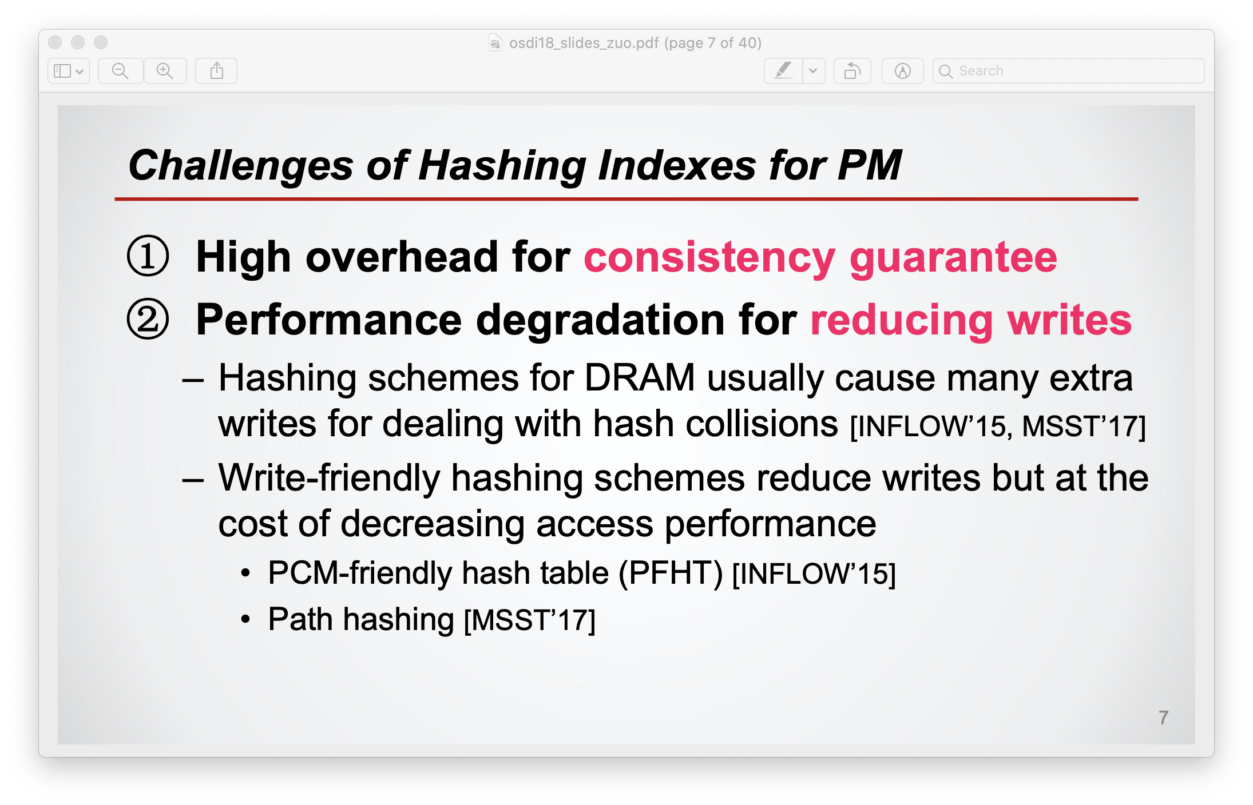

Slide 22
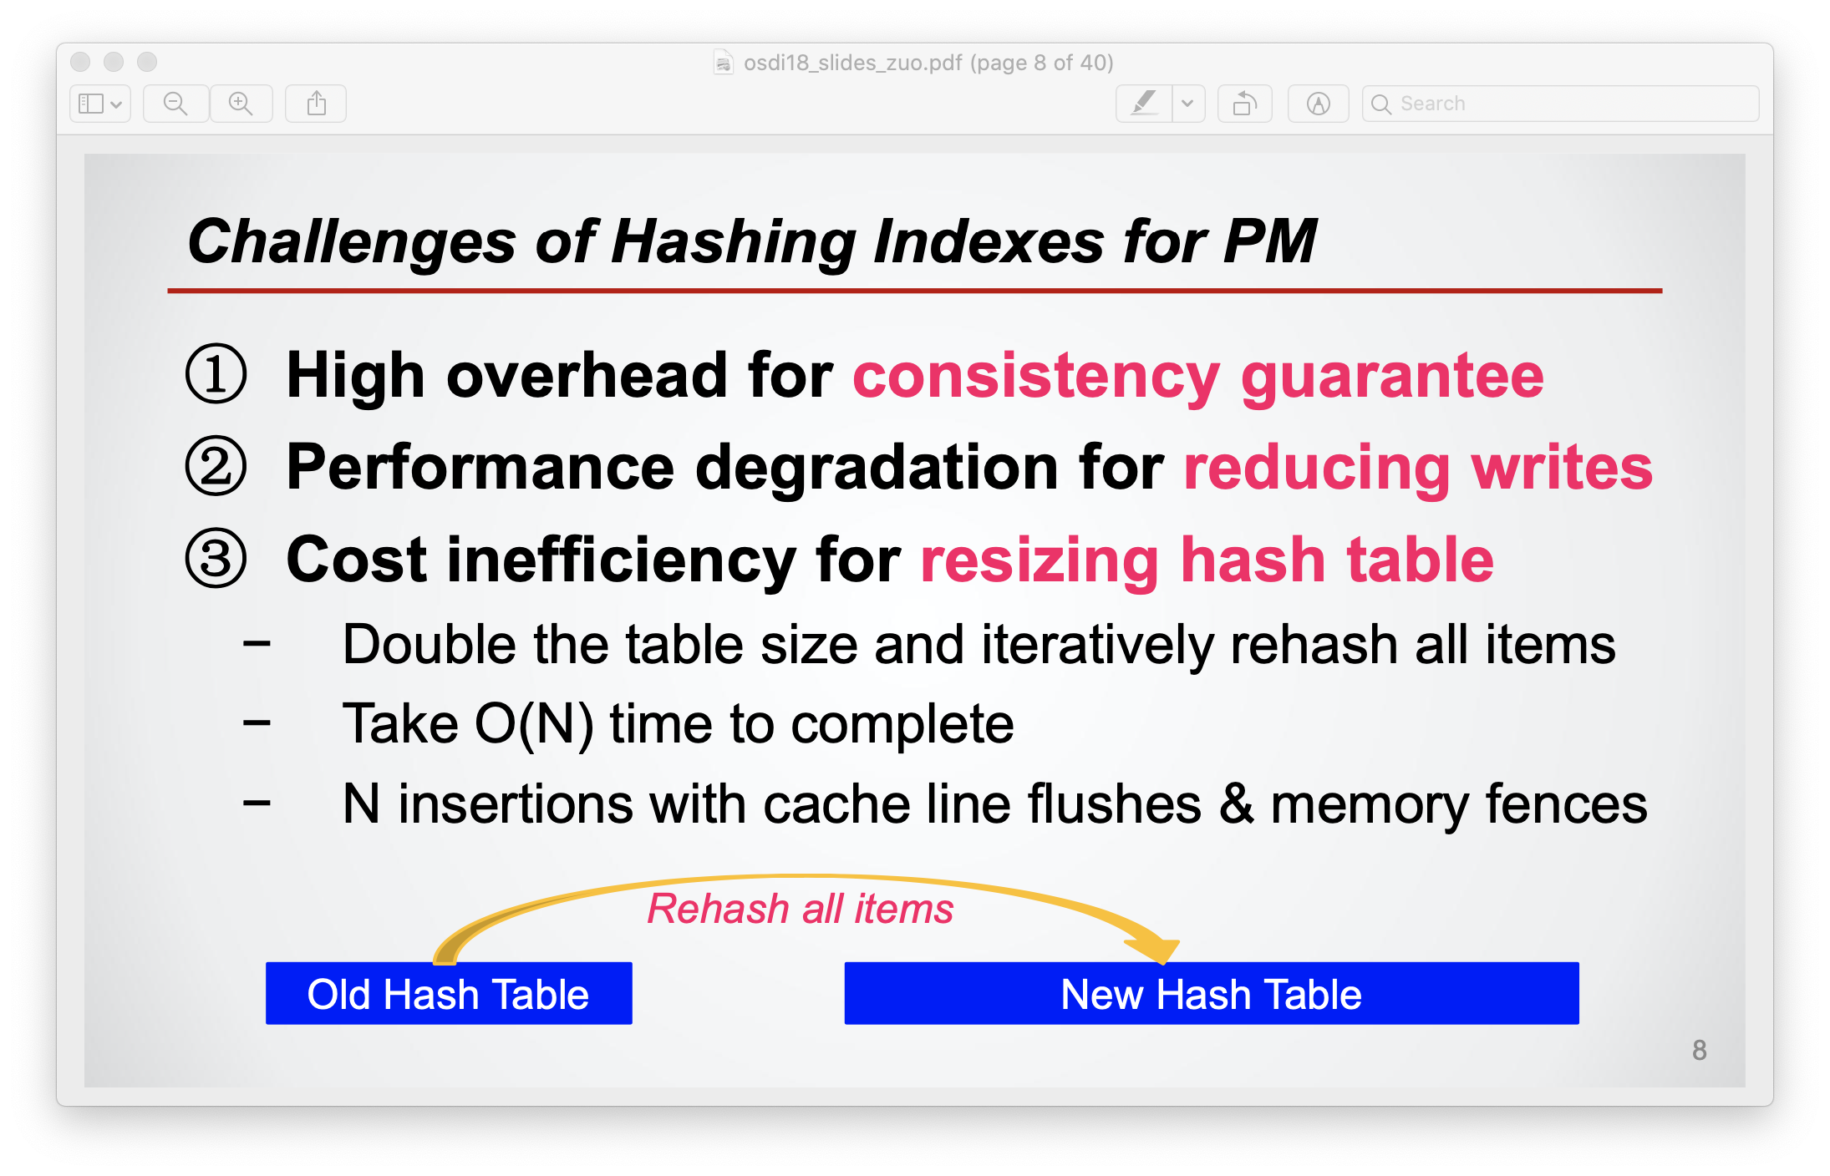

Slide 23
Deliver?

Slide 24
Outline
Motivation
Persistent Memory
Persistent regions
Consistent updates
Durable Memory Transactions
Evaluation

Slide 25
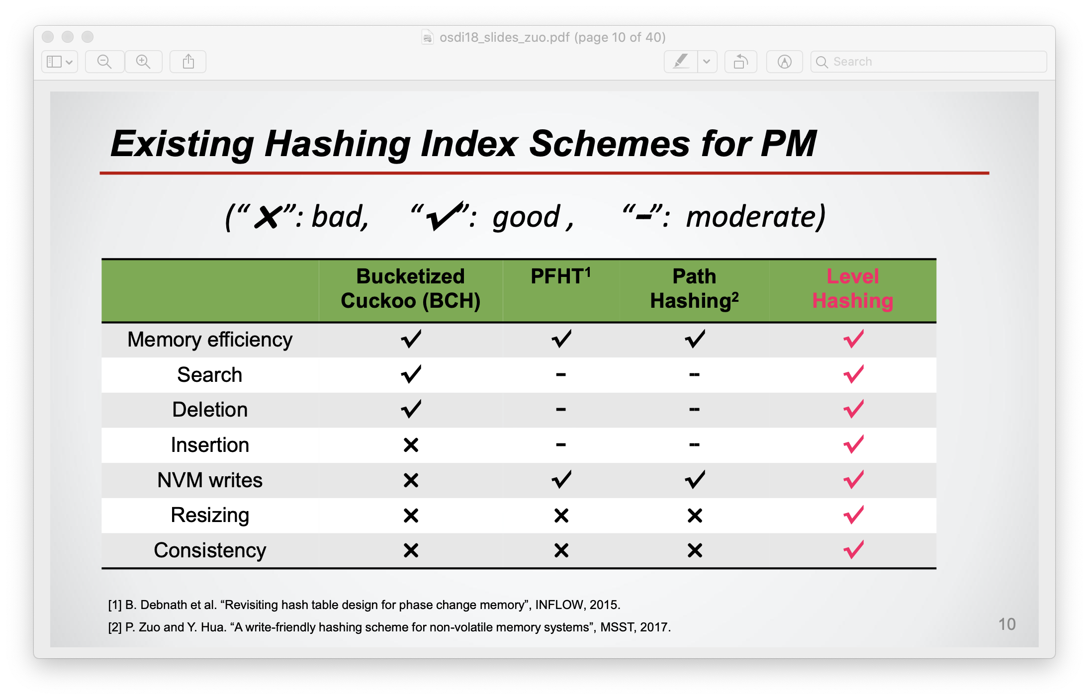

Slide 26
Techniques?
Basic Data Structures and Operations
Consistency
Durable Memory Transactions

Slide 27
Persistent Regions
Virtual memory segments stored in SCM
Enable programming flexibility
Persist across restarts
Notes:
Persistent regions are segments of virtual memory that provide programmers with direct user-mode access to SCM. As SCM has limited endurance, we rely on the underlying hardware to perform wear-leveling and mask out any bad storage cells.
Persistent regions provide programming flexibility…
Persistent regions and their contents persist across restarts…

Slide 28
Persistent Regions
Virtual memory segments stored in SCM
Enable programming flexibility
Persist across restarts
Two region types
Persistent region type | API
Static | pstatic var
Dynamic (persistent heap) | pmalloc
Persistent data
New allocation
myNamedRoot
Notes:
Two types of regions:
-static regions are similar to the data segments of UNIX executables. A programmer annotates a variable using the pstatic keyword and the compiler allocates it in the persistent static region.
-dynamic regions provide a persistent heap which allows programmers allocate chunks of persistent memory during runtime through the pmalloc function similarly to malloc of volatile heaps. A programmer has to ensure that any new space allocated dynamically is made reachable from other locations that are already persistent and accessible. Here is where static variables are useful because they can be used to bootstrap reachability by providing a persistent named root.

Slide 29
Persistent Heap
API
pmalloc(sz, ptr)
pfree(ptr)
Organization
Hoard for allocations < 8K
dlmalloc for larger
Persistent Bitmap Vector
Hoard Indexes
Persistent
Superblocks
Notes:
Pmalloc takes a persistent pointer as an argument to ensure that memory is not leaked if the system fails just after an allocation.
Originally designed to achive good multiprocessor scalability
-Heap is split into superblocks, which are fixed sized regions containing an array of fixed size blocks.
-Heap stores persistent bitmap vector per superblock to track allocated blocks. So allocating memory requires only one write to SCM to set the bit in the vector. Reduces latency to allocate a block, reduces wearout due to writing metadata.
We keep Hoard's indexes in volatile memory, to speed up allocation. These are reconstructed when a program starts.

Slide 30
Virtualizing Persistent Regions
Problem
Share finite amount of SCM
Sandbox memory leaks
Mnemosyne
Swaps SCM pages to per-region backing file
Records virtual-to-physical mappings of regions and reconstructs them after reboot
Notes:
We need virtualization primarily for two reasons:
To time and space multiplex a finite amount of SCM between multiple users.
To sandbox and prevent memory leaks in one application consuming memory that could be used by others.
Mnemosyne virtualizes SCM by
Swapping SCM pages …
Recording

Slide 31
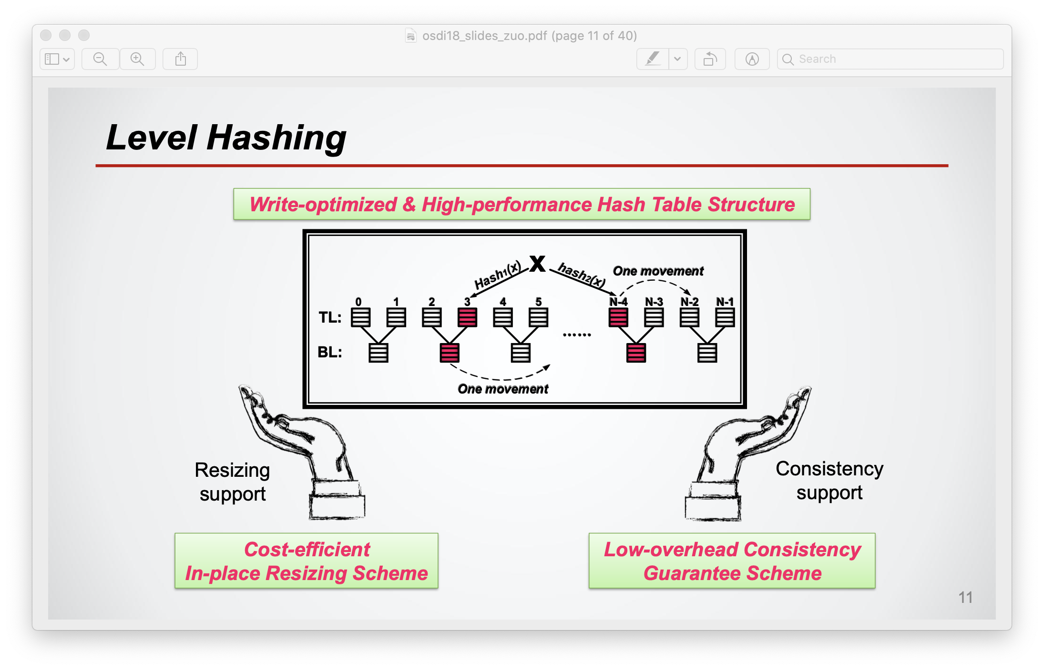

Slide 32
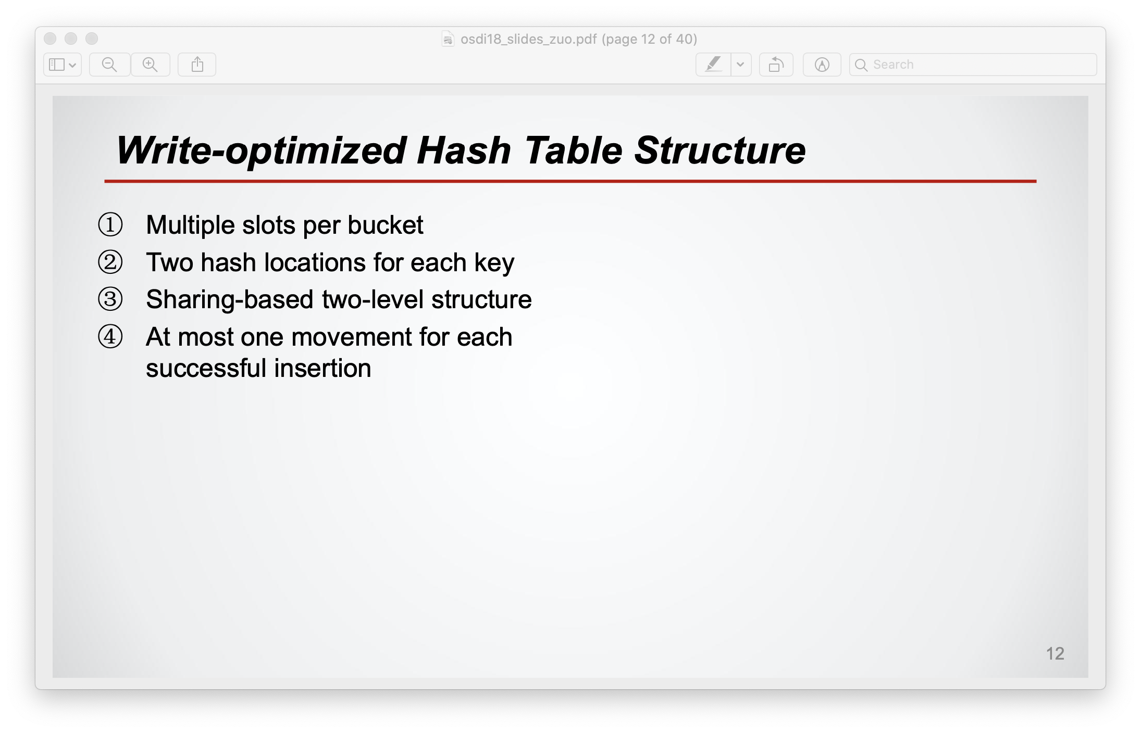

Slide 33
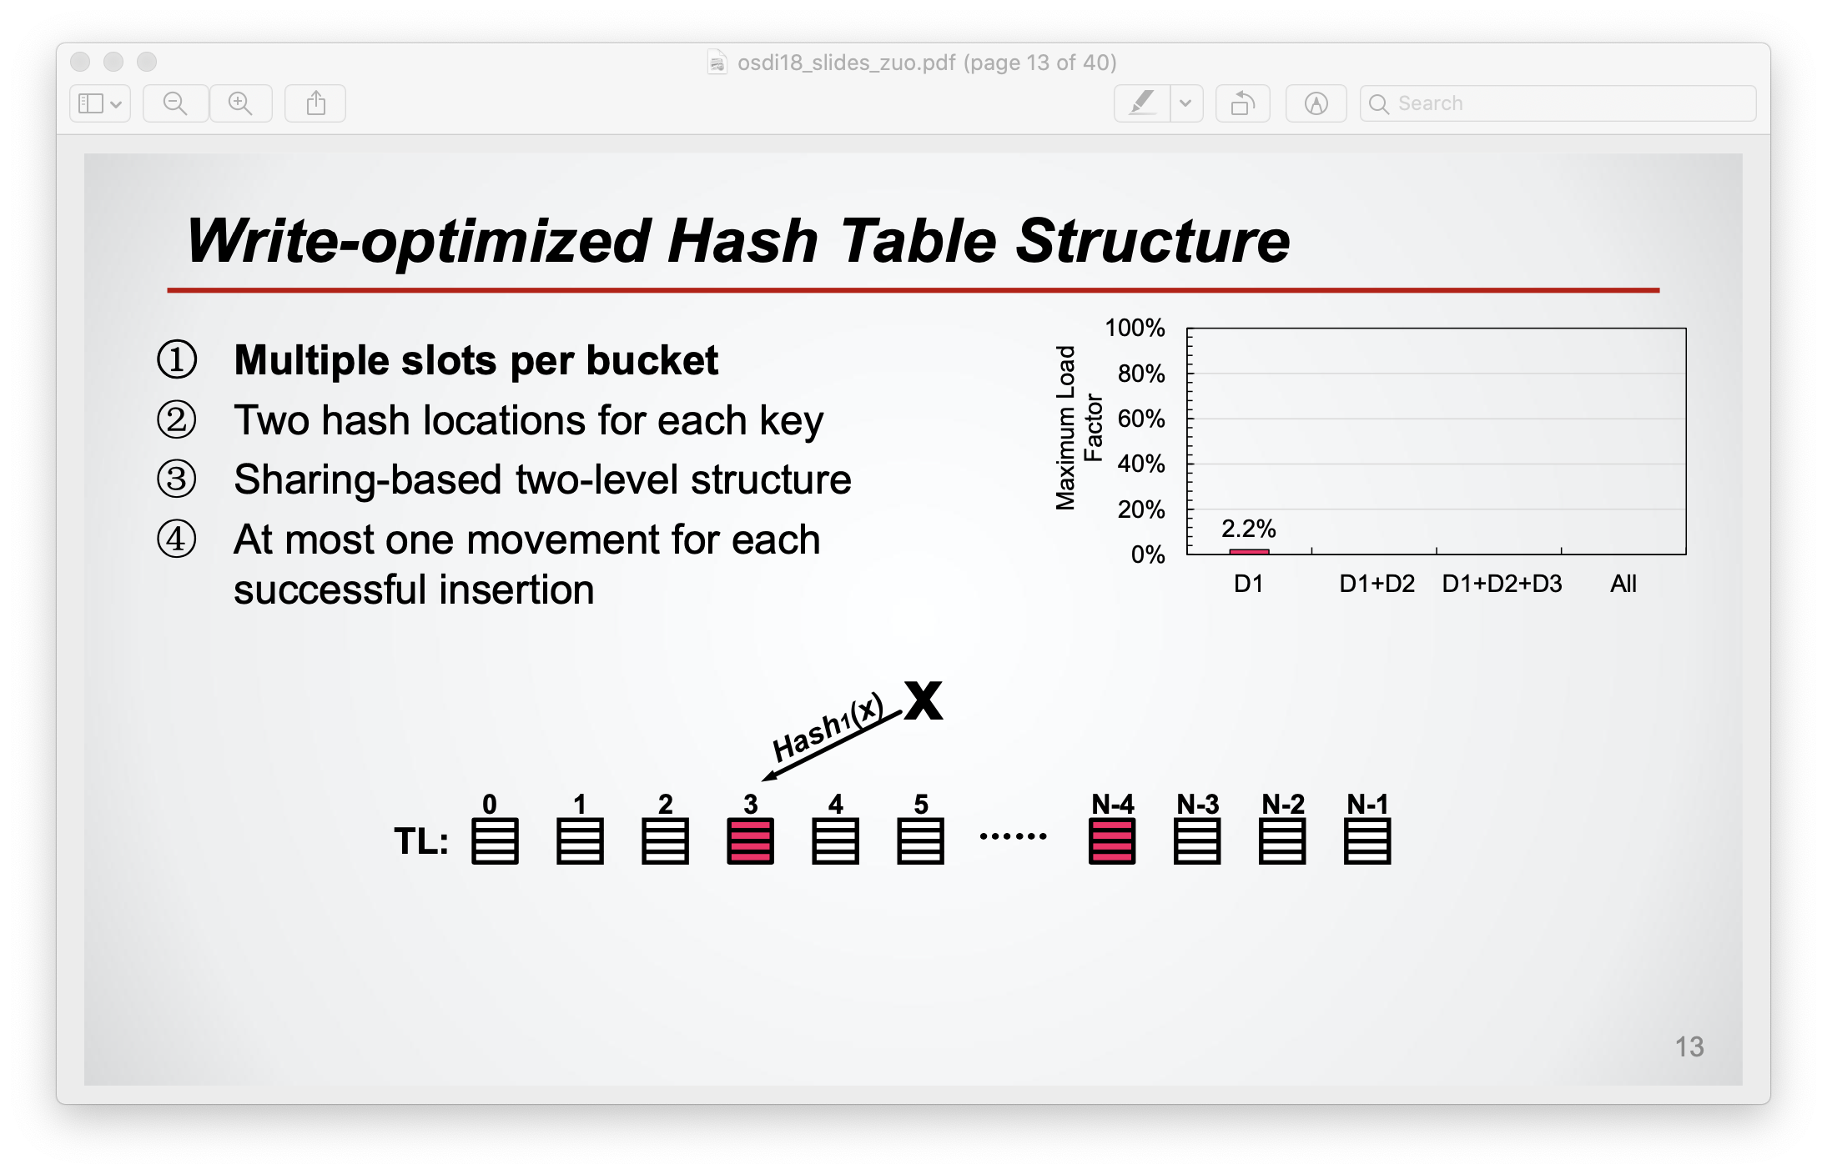
What is maximum load factor?

Slide 34
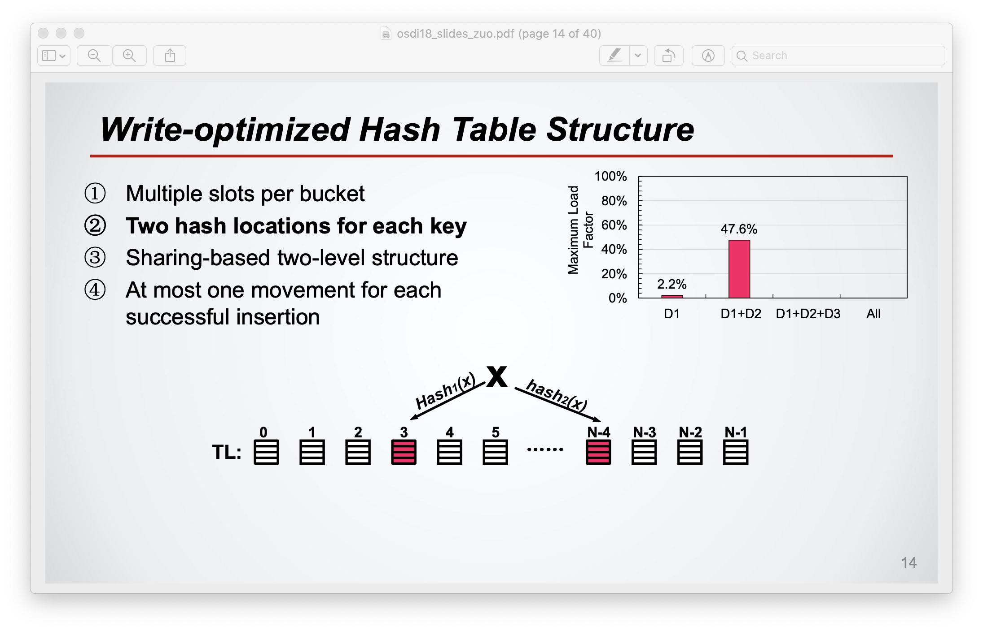

Slide 35
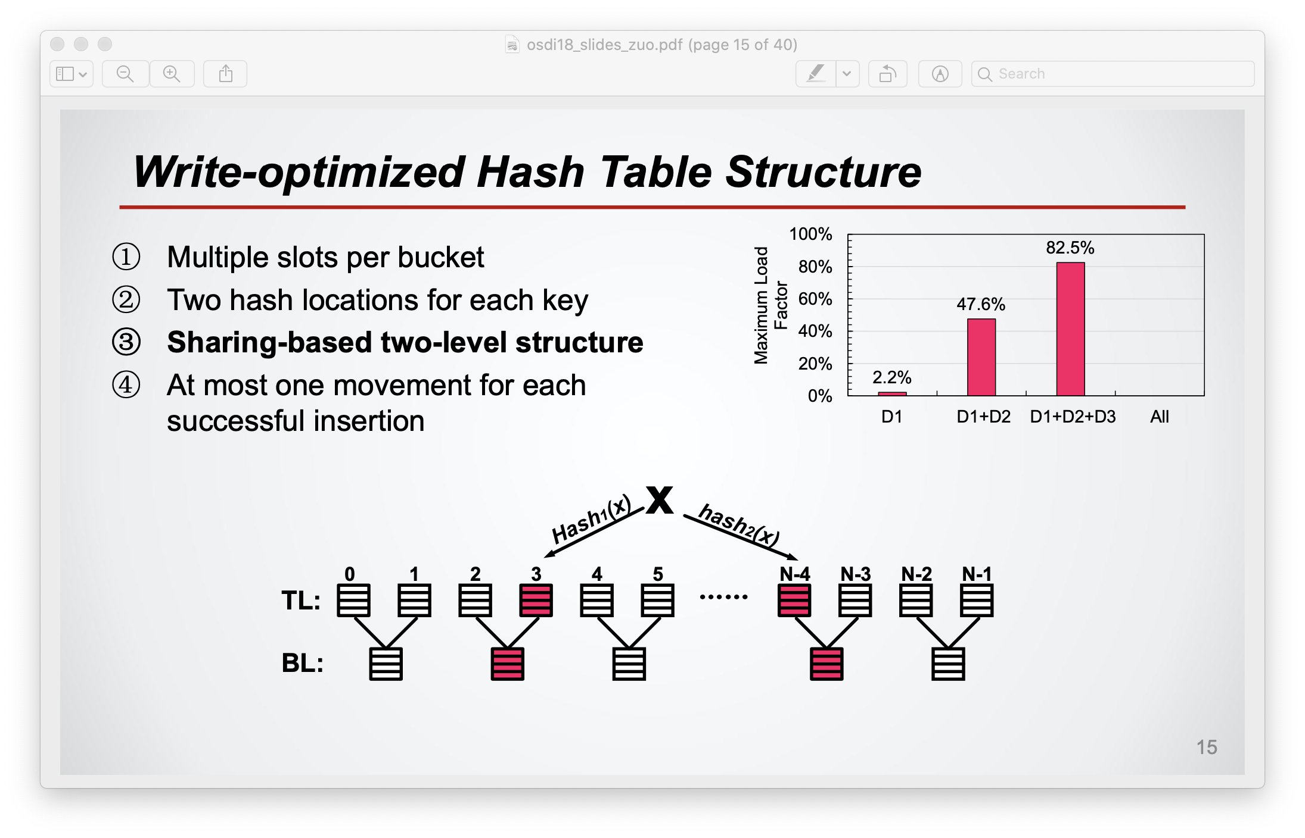

Slide 36
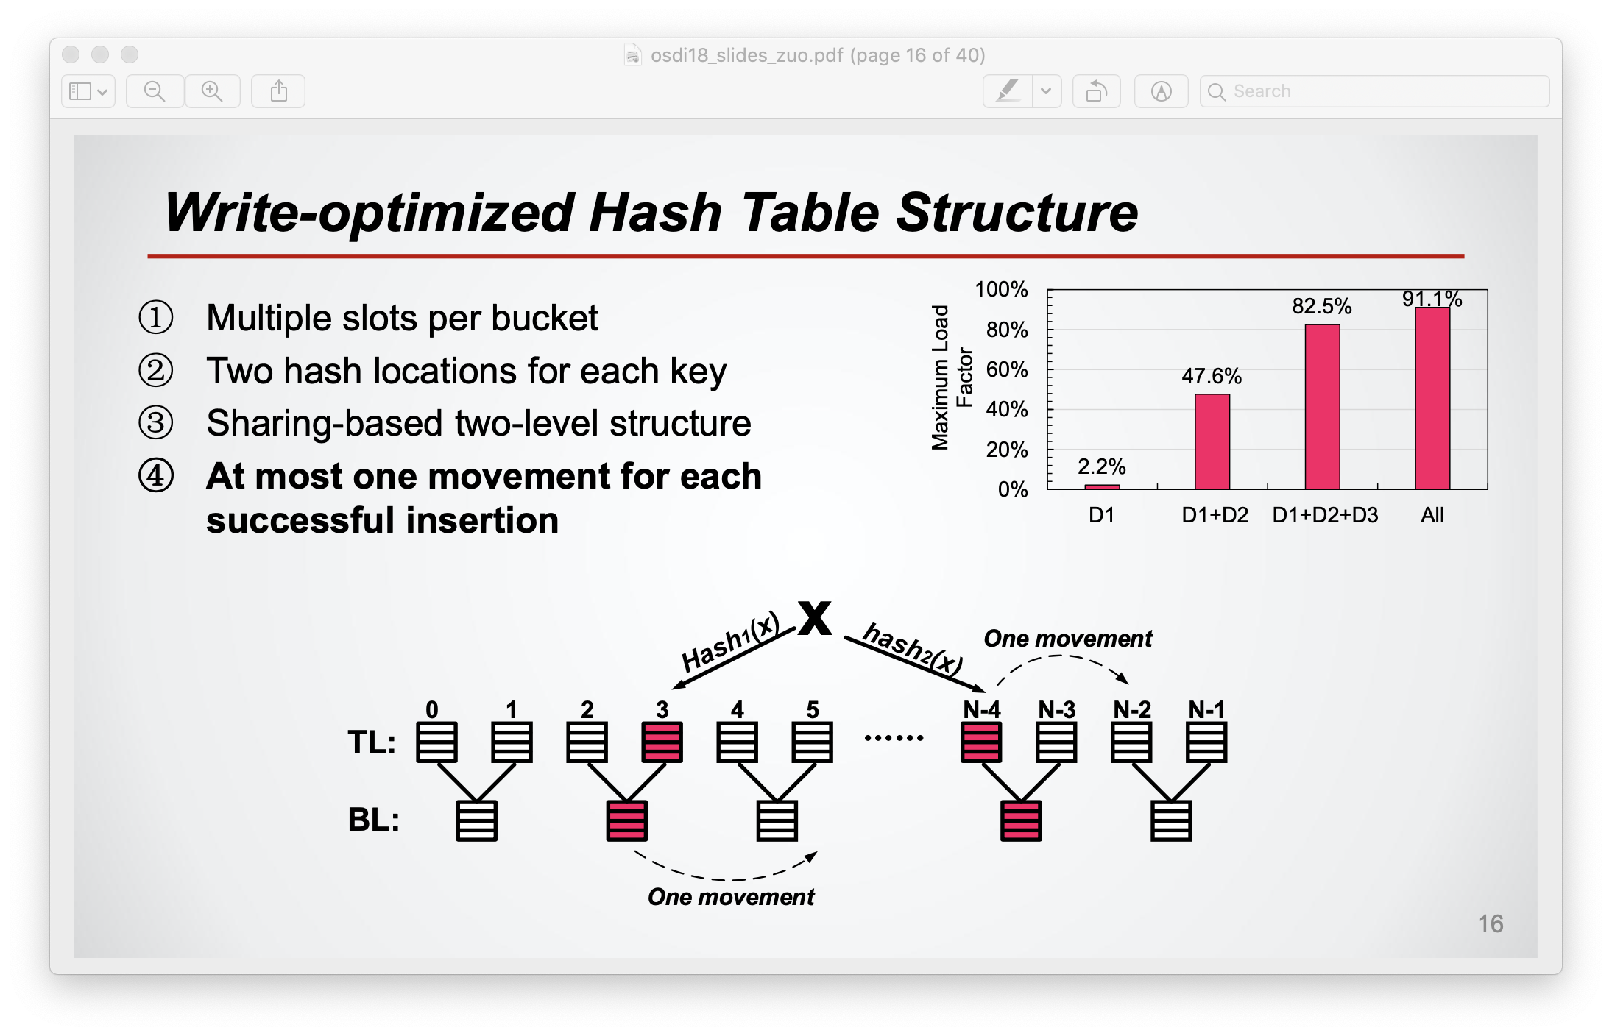

Slide 37
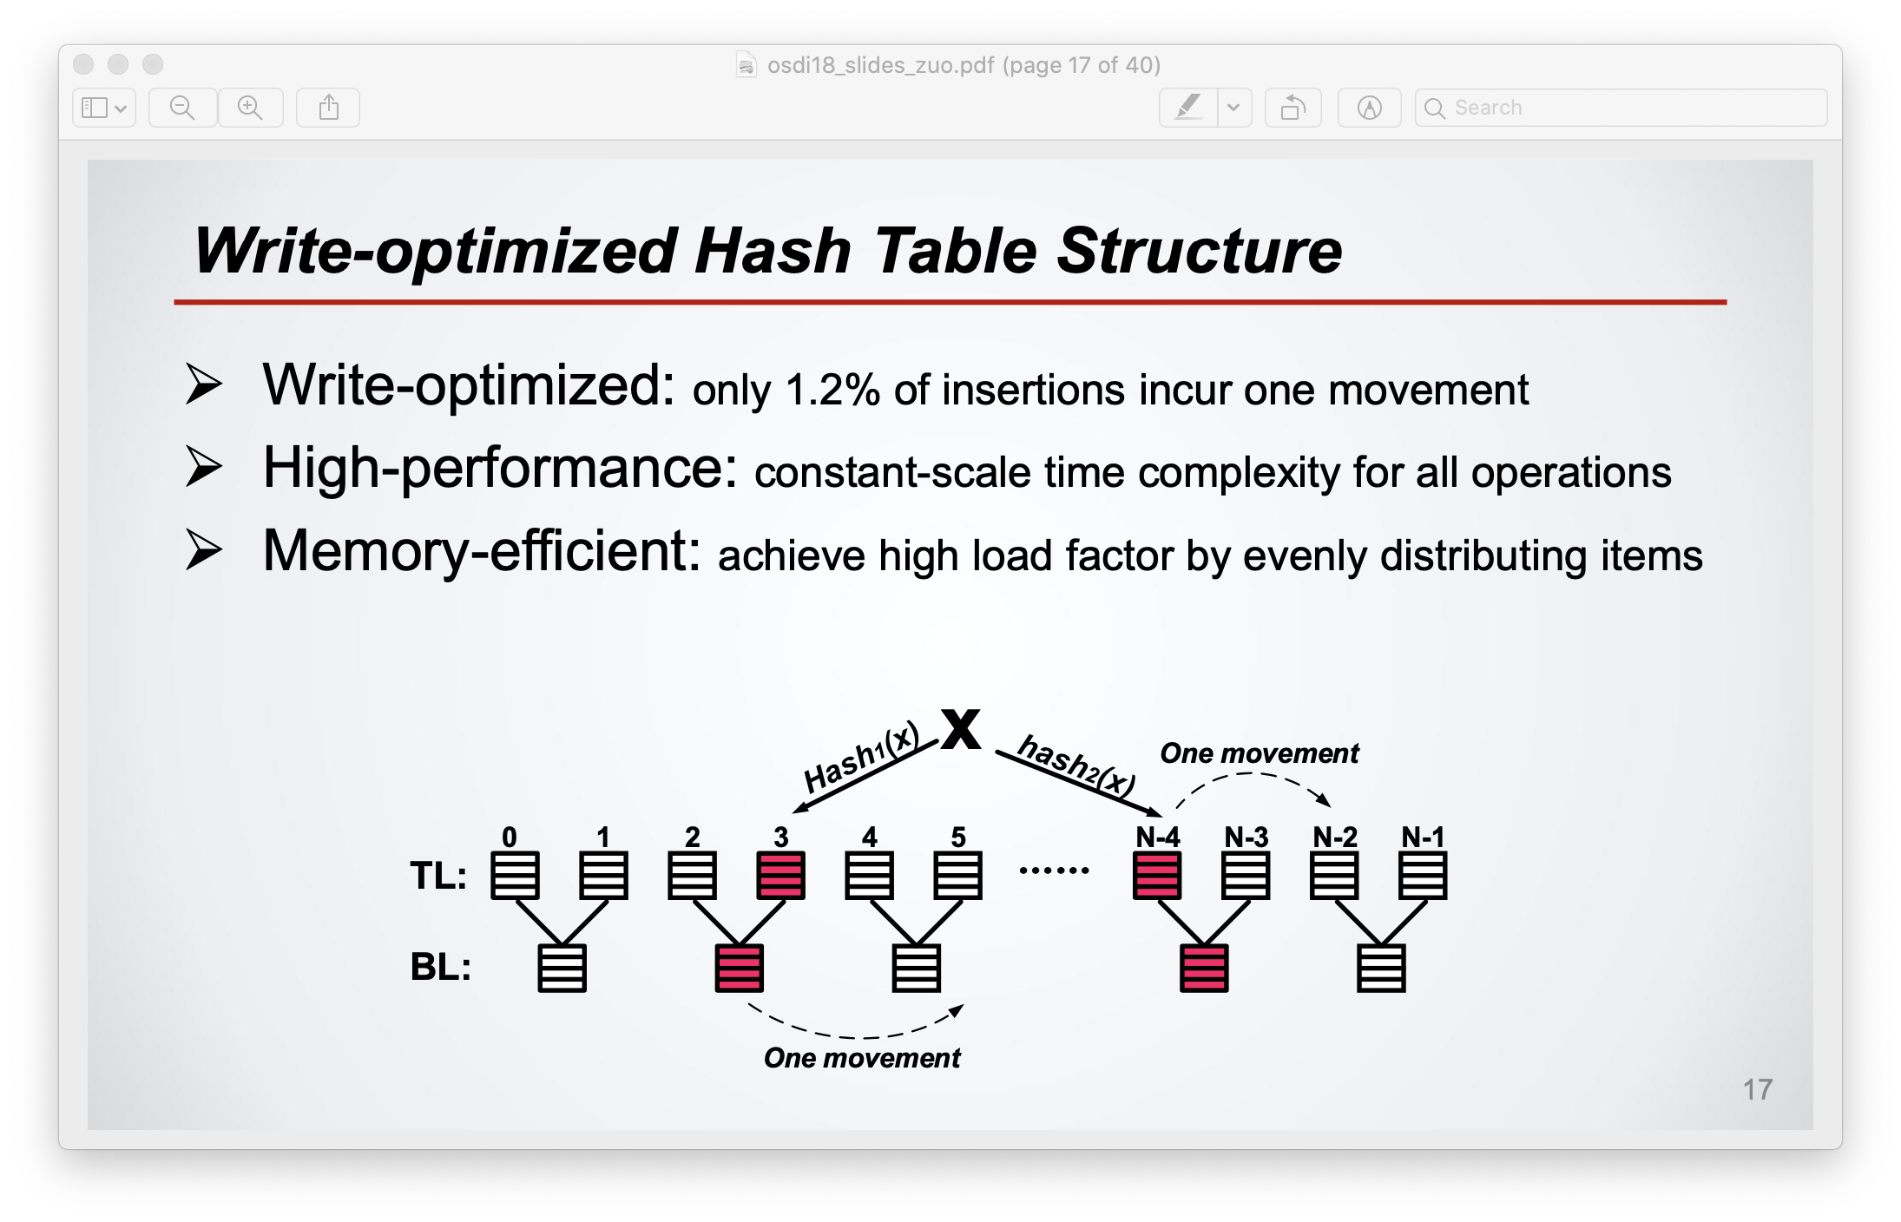

Slide 38
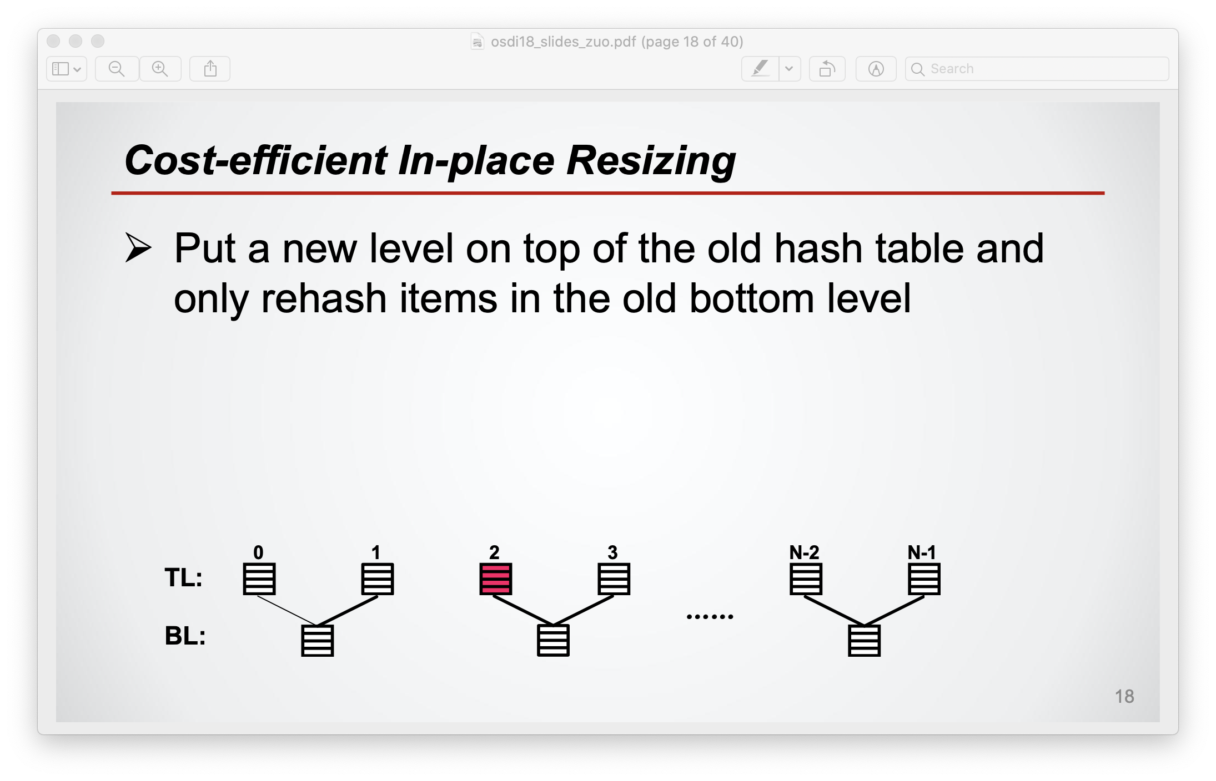

Slide 39
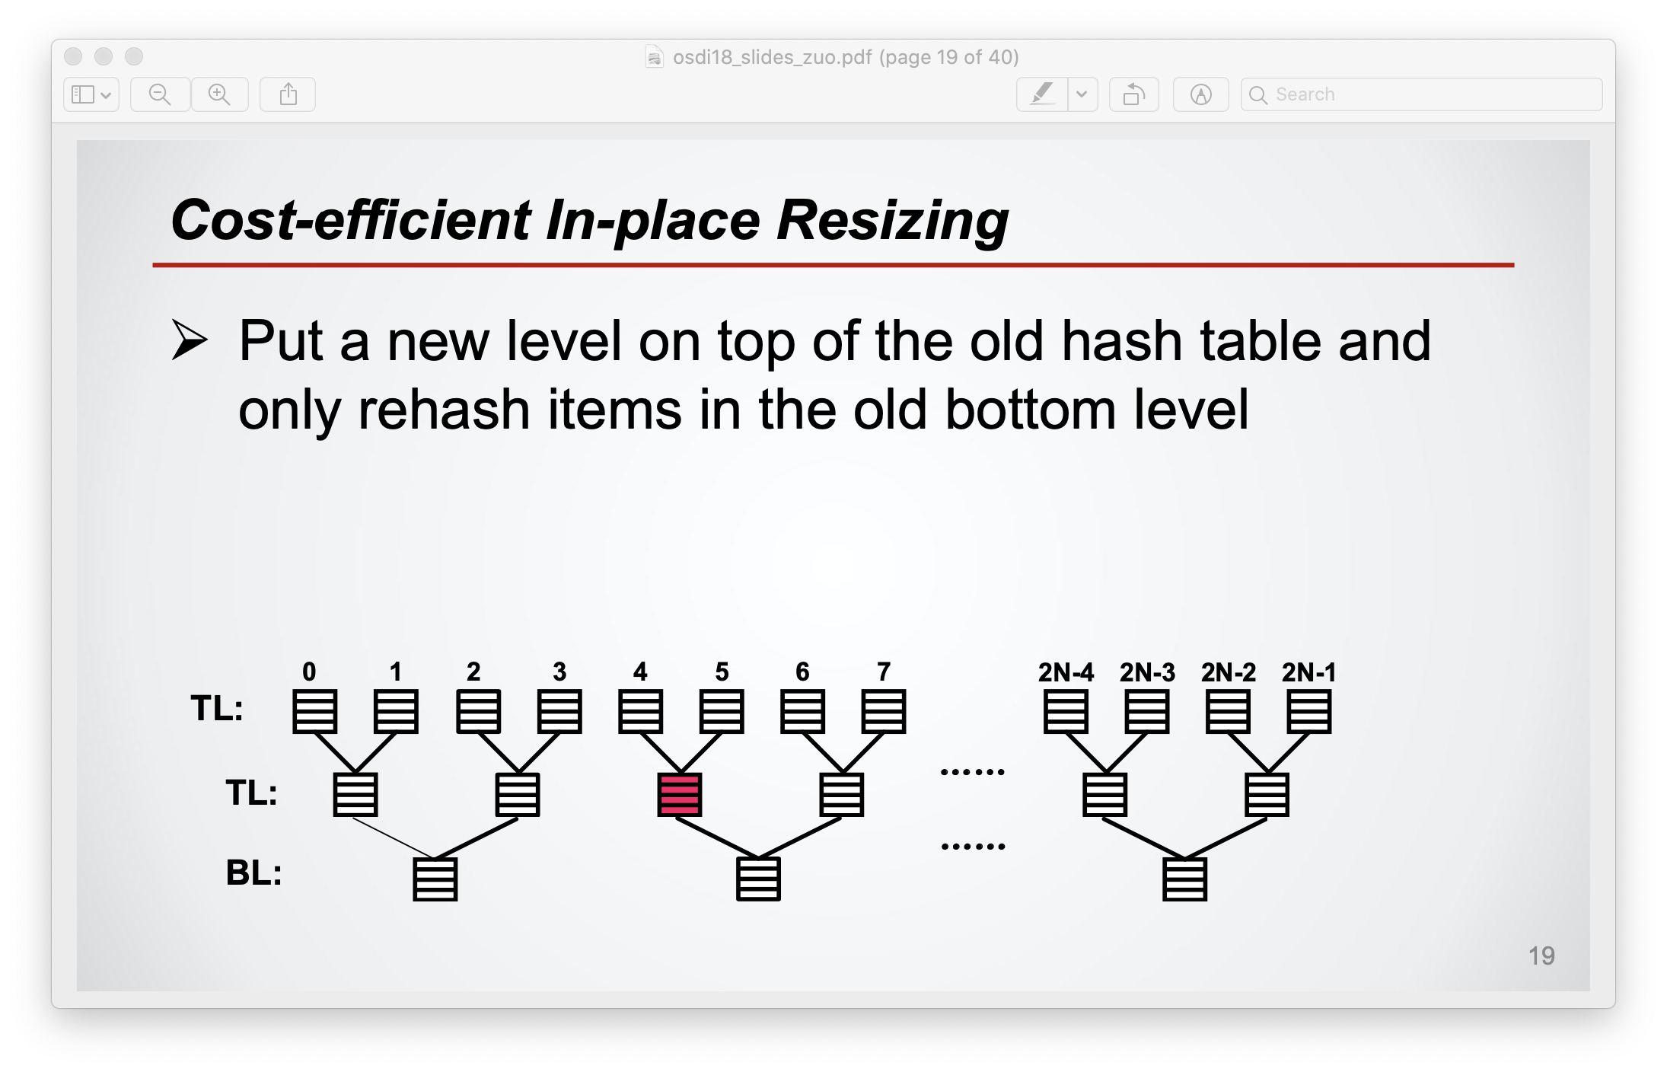

Slide 40
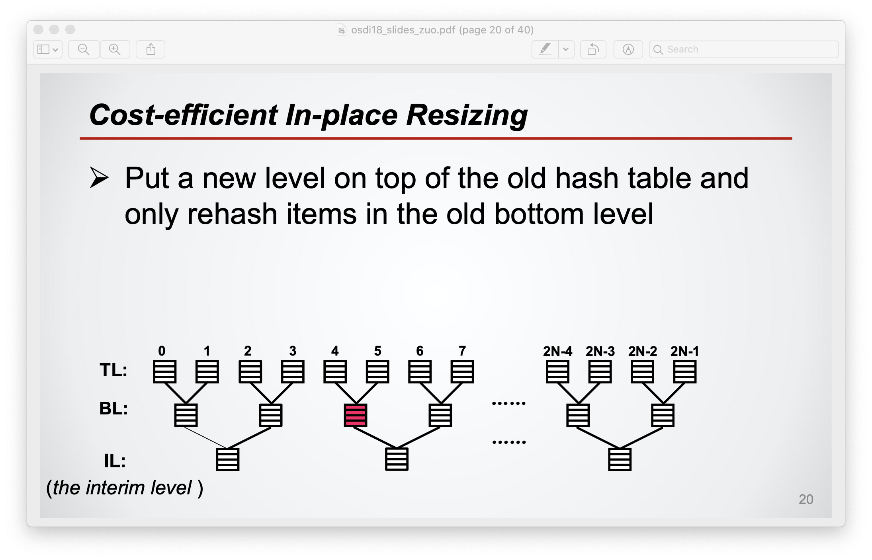

Slide 41
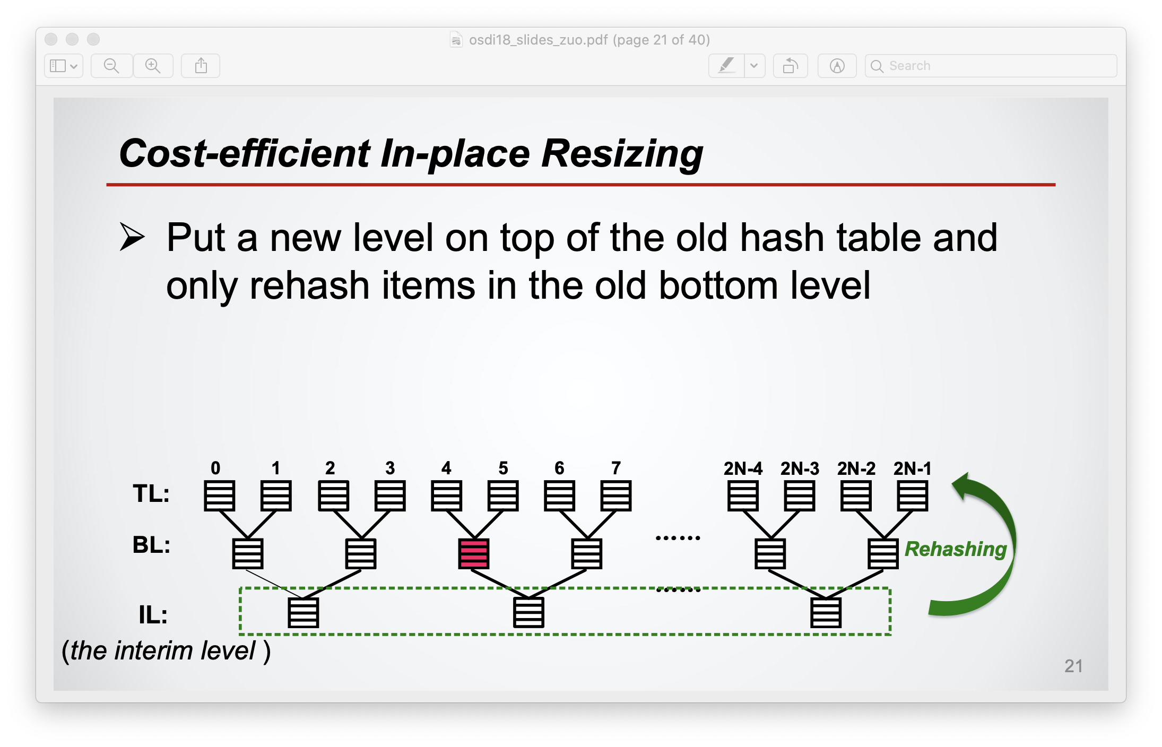

Slide 42
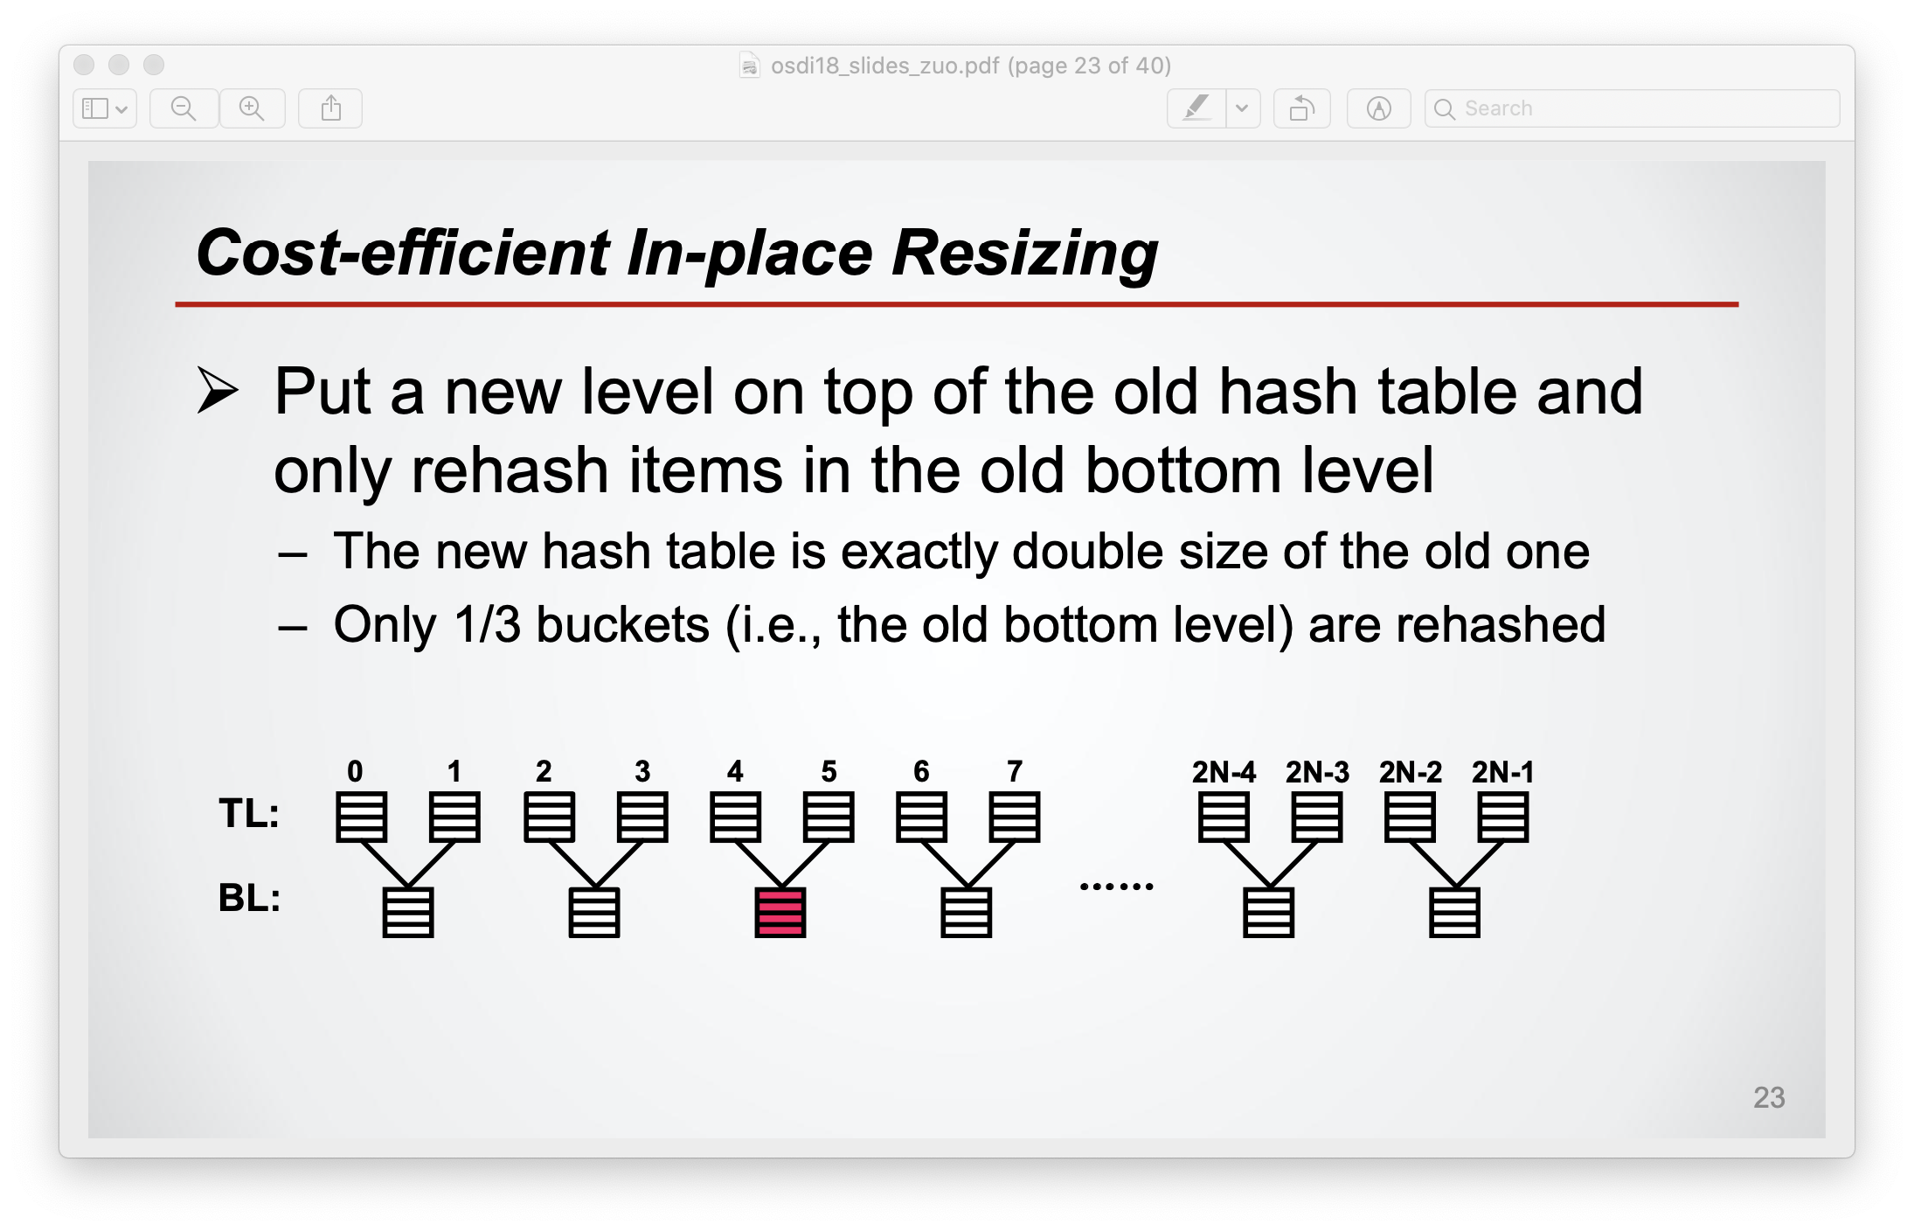

Slide 43
Other Optimizations?
Bottom-to-top movement (b2t) scheme
Observation: bottom has more elements after resize
Move existing bottom element when buckets full
Improve search performance
Start search with more full bucket (top or bottom)

Slide 44
Consistency

Slide 45
Consistent Updates
Support updating data without risking correctness after a failure
Write-back
cache
SCM
value
valid
0xDEADBEEF
R.value = 0xC0FFEE
R.valid = 1
R.value = 0xC0FFEE
R.valid = 1
value
valid
0xC0FFEE
0
1
1
Notes:
Consistent updates are operations that …
-A key challenge in implementing consistent updates is ensuring the data reaches SCM in the right order...
To better understand the problem, consider this code fragment which first updates a value and the sets the valid bit to indicate the validity of the value. Both updates are cached in the volatile cache. It is possible that the cache eviction policy evicts the cacheline containing the valid bit first. This causes a consistency problem in the case of a failure as the valid bit indicates that the value is valid even if it is not.

Slide 46
Consistent Updates
Support updating data without risking correctness after a failure
Rely on conventional CPU primitives for ordering
Flush
Fence
Write-back
cache
SCM
value
valid
0xDEADBEEF
R.value ← 0xC0FFEE
FLUSH(&R.value)
FENCE
R.valid ← 1
value
valid
0xC0FFEE
0
1
Notes:
Other proposals solve this problem by using a non-conventional processor that provides programmers with epochs to control the cache eviction policy.
Mnemosyne instead relies on conventional processor primitives for ordering as this would encourage the adoption of SCM before any special processor support becomes available.
-Flush: forces cached data out to SCM
-Fence: prevents subsequent writes from completing before preceding writes and flushes

Slide 47
Consistent Updates
Operations that support updating data without risking correctness after a failure
Four update operations
Update | API | Usage example
Single-variable | HW primitive | Set flag
Append | log_append | Append to journal
Shadow | pmalloc + single-var | Update tree node
In-place | atomic { } | Update double linked list
Notes:
The second key component is consistent updates, operations that …
We provide four update operations. Having a spectrum of operations allows us to optimize updates based on the access pattern.
First mechanism, the single-variable, is the most basic one, it is a hardware provided primitive and supports atomically updating a single word.
The other three support updates composed of multiple writes.
We support append-style updates via a log. They can be used to update log-style structures such as a journal
We support shadow update via a combination of pmalloc and single-variable update. They can be used to update tree-like structures.
We support in-place updates via transactions. They can be used to update any data-structure.

Slide 48
Consistent Updates
Support modifying persistent data without risking correctness in the presence of failures
Update | API | Usage example
Single-variable | HW primitive | Set flag
Append | log_append | Append to journal
Shadow | pmalloc + single-var | Update tree node
In-place | atomic { } | Update double linked list
Append
Shadow
In-place
replica
replicas

Slide 49
High-Performance RAWL
Strawman
Tornbit
1
1
1
0
1
0
1
0
1
0
1
0
1
0
1 bit
1
63 bits
Notes:
To achieve high performance, the log allows later writes to complete while earlier ones did not.
This implies that if the system crashes, later writes may have completed while earlier ones did not.
After a system crash, the recovery manager has to identify whether all writes that comprise an append operation completed. This is similar to the torn-write problem in databases.
Strawman: The usual way you solve this problem…

Slide 50
Detecting Torn Writes
Missing Write
1
1
1
0
1
0
1
0
1
0
0
1
0
1

Slide 51
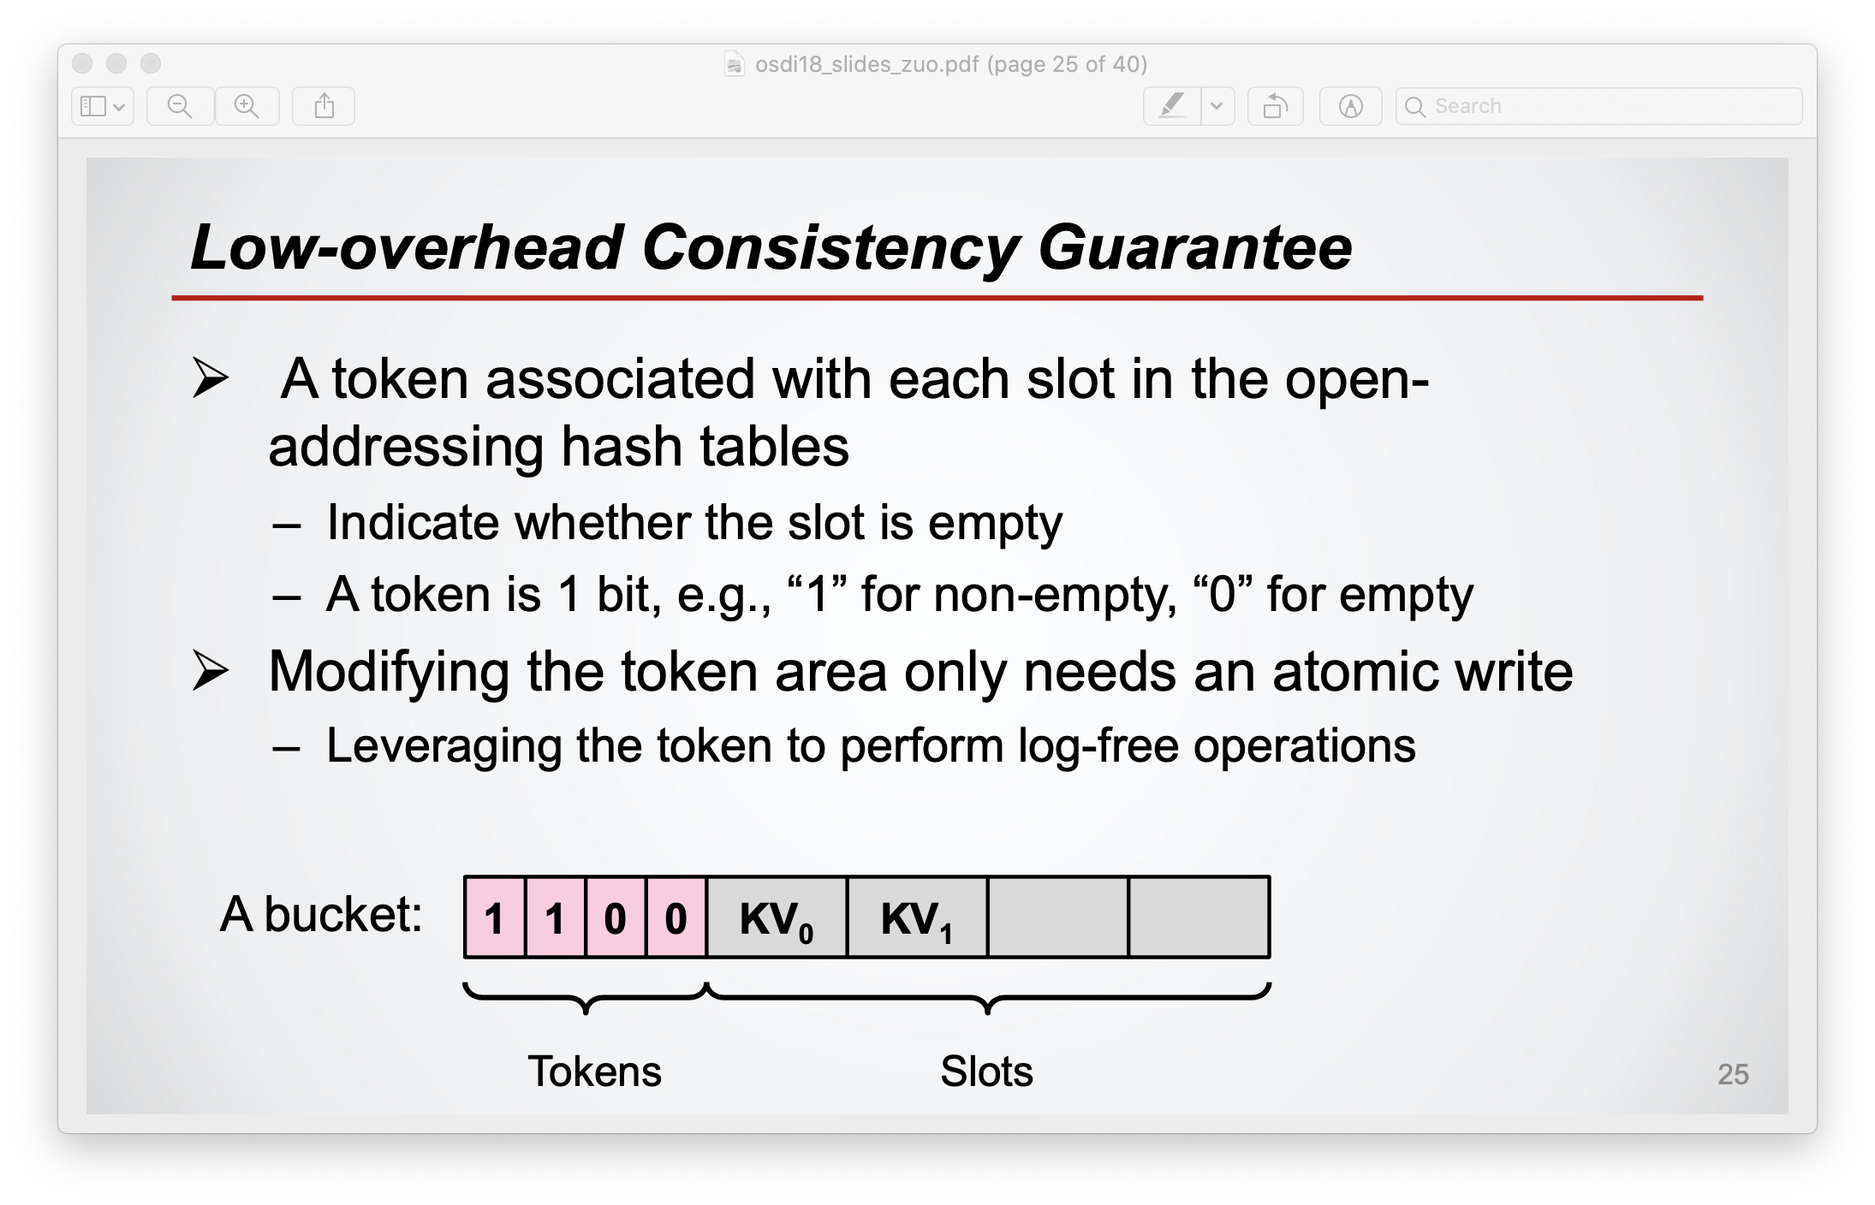

Slide 52
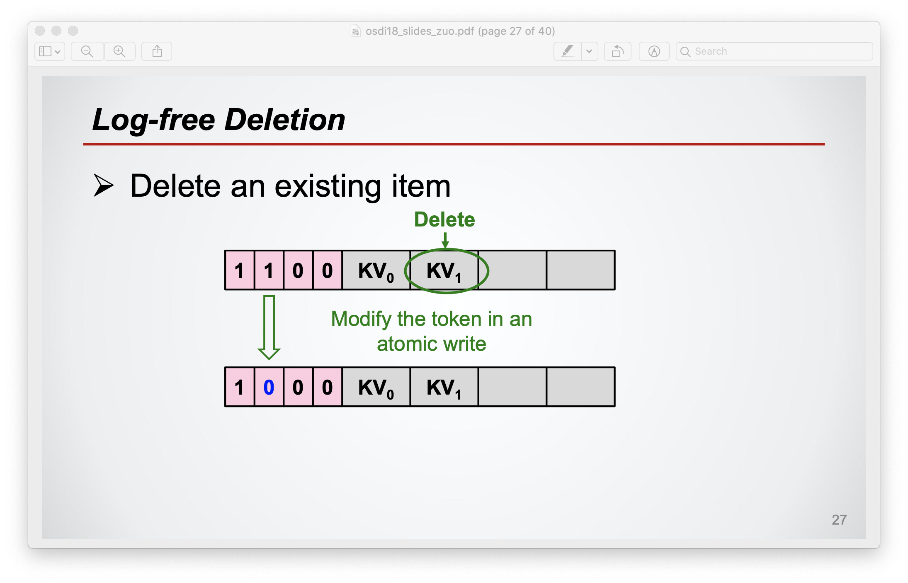

Slide 53
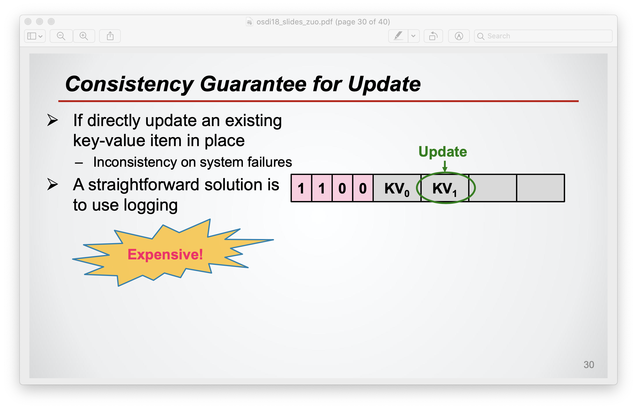

Slide 54
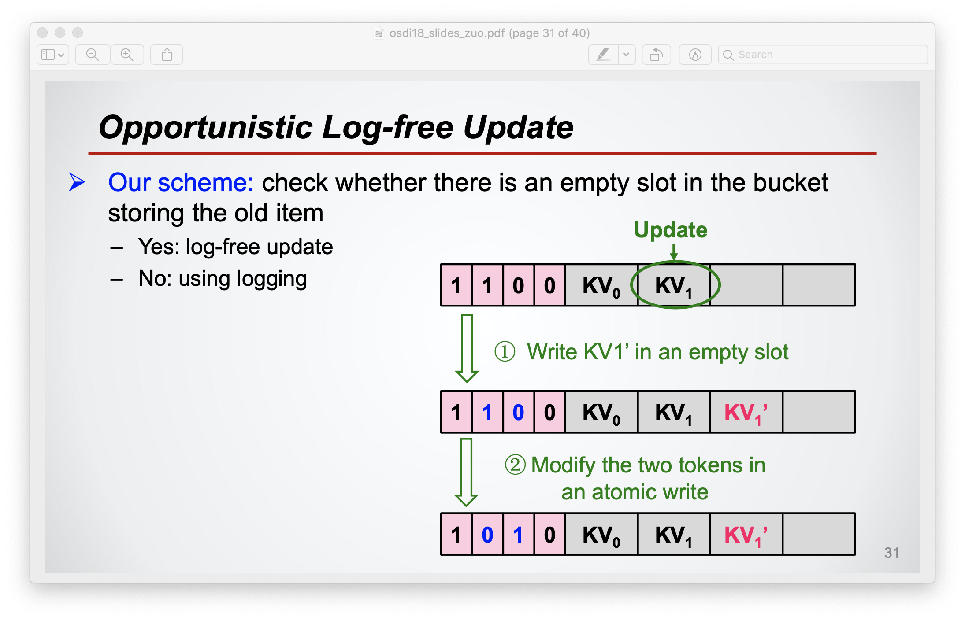

Slide 55
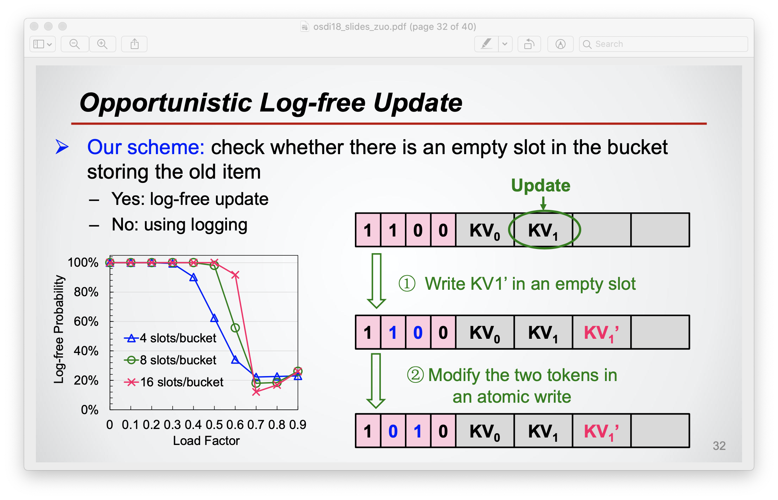

Slide 56
Durable Memory Transactions
Compiler instruments atomic blocks
Runtime supports ACID transactions
Based on TinySTM
atomic {
R.value = 0xC0F;
R.valid = 1;
}
begin_transaction();
stm_store(&R.value, 0xC0F);
stm_store(&R.valid, 1);
commit_transaction();
Notes:
Memory transactions is a form of consistent update which enables updating any form of data stucture in-place.
Mnemosyne supports memory transactions with a combination of compiler and runtime.
Compiler transforms ATOMIC code blocks with calls into a transaction runtime system …
Runtime executes atomic blocks as full fledged ACID transactions.
-Atomicity and durability …
-Isolation …
-We base our runtime system on TinySTM, a software transactional memory system, which we modified to force the log of intended updates to persistent memory before committing a transaction. Upon a restart, Mnemosyne aborts any in-progress transactions and cleans up the log.

Slide 57

Hash Table Example
pstatic htRoot = NULL;
htRoot
0x0000CAFE
Static
0000000000
main() {
if (!htRoot)
pmalloc(N*sizeof(*bucket), &htRoot);
}
update_hash(key, value) {
atomic {
pmalloc(sizeof(*bucket), &bucket));
bucket->key = key;
bucket->value = value;
insert(hash, bucket);
}
}
Persistent Heap
key
value
Notes:
Here is an example where memory transactions are used to update a hash table.
The root of the hashtable is allocated in a static persistent region.
When the program starts for the first time, it uses PMALLOC to allocate the hashtable in the persistent heap. PMALLOC takes a persistent pointer as an argument to ensure that the allocated memory is accessible if the system fails just after allocation.
A memory transaction is used to update the hashtable. The transaction atomically allocates space for the new bucket, it sets the <key, value> pair of the bucket and inserts the bucket into the hashtable.
The transaction guarantees atomicity so that a failure midflight the transaction won’t leave the hashtable in an inconsistent state like missing a bucket.
In summary, upon a restart, the hashtable is accessible via the persistent named root, and contains all <key, value> pairs successfully written to it.

Slide 58
Conclusion: Mnemosyne
Exposes SCM directly to programmers as persistent memory
Relies on conventional CPU primitives for ordering
Enables low-latency, consistent, in-place updates via durable memory transactions
?

Slide 59
